Slide 1
College Placement Analysis
Source: https://www.kaggle.com/code/mahmoudredagamail/college- student-placement
Dataset: College Placement Dataset
EMAIL: navyab1707@gmail.com
Phone: 6305798970
LinkedIn: www.linkedin.com/in/navya-sree34314

Slide 2
INTRODUCTION
Campus placements are crucial for students and institutions.
Data analytics helps uncover trends and patterns that affect placement outcomes.
Objective: To identify major factors influencing placements and provide actionable insights.

Slide 3
Dataset Overview and Attributes
Dataset: CollegePlacement.csv
Rows: (From your notebook’s output)
Columns: (Mention number and key features)
Features:
CGPA – Academic performance
IQ – Logical/Reasoning ability
Communication Skills – Soft skills
Projects Completed – Practical exposure
Extra Curricular Score – Overall personality development
Placement – Placed / Not Placed (Target variable)

Slide 4
Data Cleaning and Preprocessing
Checked for null and missing values using PySpark functions.
Removed or imputed missing data.
Converted categorical ‘Placement’ column to numeric (1 = Placed, 0 = Not Placed).
Verified schema using df.printSchema().
Before any analysis, it’s crucial to clean the dataset. We handled missing values and standardized the placement column for better analysis accuracy.

Slide 5
Descriptive Statistics
Used df.describe() to find summary statistics:
Mean, Min, Max, Standard Deviation
Example Insights:
Average CGPA: ~7.2
Average IQ: ~110
Average Communication Skills: ~7
This step helps us understand the data’s general behavior whether it’s balanced, skewed, or needs normalization.

Slide 6
Overall Placement Rate
Calculated placement rate using:
avg("Placed") * 100
Result: e.g., 62.5% of students were placed.
Interpretation: More than half the students secured placement, showing moderate employability.
This rate gives an overall performance indicator of the institution’s placement success.

Slide 7
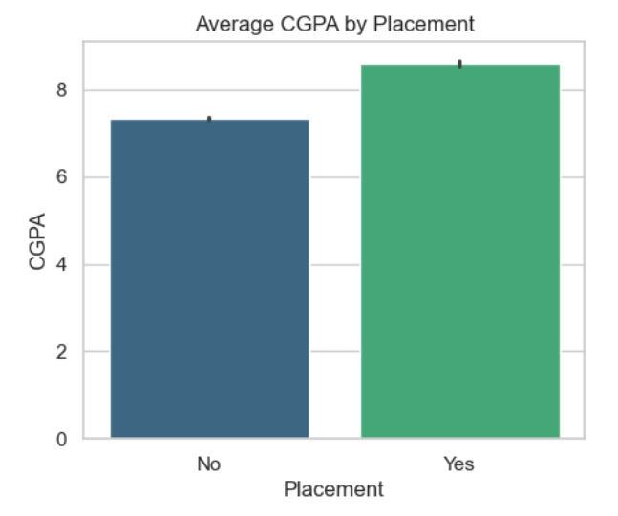
Academic Performance vs Placement
Grouped by “Placement” and calculated average CGPA.
Found that placed students have higher CGPA compared to not placed ones.
Example:
Placed: 8.1
Not Placed: 6.7

Slide 8
IQ vs Placement
Compared average IQ between placed and not placed students.
Observation:
Placed: IQ ≈ 115
Not Placed: IQ ≈ 105
IQ reflects analytical and problem-solving skills. The data shows a clear correlation between higher IQ and placement success.

Slide 9
Correlation Analysis
Used corr("Academic_Performance", "CGPA").
Result: Positive correlation (~0.7).
Interpretation: Strong link between academic performance and CGPA
Correlation analysis helps understand relationships between variables. Here, higher academic scores are associated with higher CGPA, indirectly impacting placements.

Slide 10
Skills and Project Factors
Compared multiple skill-related factors:
Projects Completed vs CGPA: Students completing more projects have slightly higher CGPA.
Communication Skills vs Placement: Better communication scores lead to higher placement.
Extra Curricular Score vs Placement: Active participation in non-academic areas improves overall placement rate.
Soft skills and hands-on experience are equally important alongside academics. Companies look for overall personality.

Slide 11
Key Insights
Major takeaways:
High CGPA and IQ → better placement rate.
Communication & soft skills significantly impact selection.
Extracurriculars and projects add competitive advantage.
Overall placement rate shows scope for improvement.

Slide 12
Conclusion
The analysis highlights that placements depend on both academic and non-academic factors. Students excelling in multiple areas have the best chances of placement.
This project demonstrates how data analytics can guide decision-making in education. In the future, predictive models can help identify at-risk students early.

